Slide 1

Testing Flappy Bird
Note that slides 3-11 are all short videos (10sec max)

Slide 2
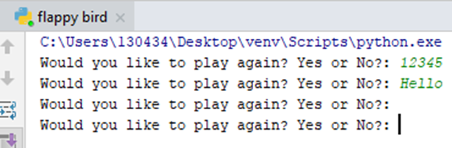
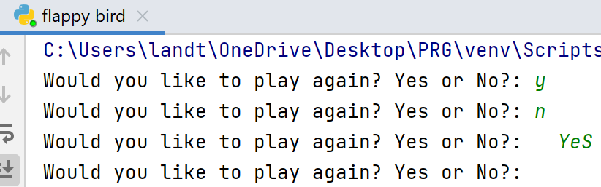
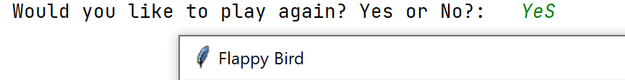
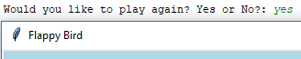
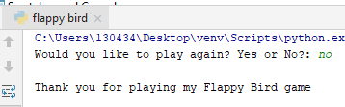
Purpose of the test | Data entry for the test | Expected Result | Actual Result | Outcome of Test
Testing _play_again (user input):
Unexpected cases
Numbers | “12345” | Re-ask if they want to play again |  | Pass
Random strings | “Hello” | Re-ask if they want to play again |  | Pass
nothing | “” | Re-ask if they want to play again |  | Pass
Boundary cases
Single netter part of yes | “y” | Re-ask if they want to play again |  | Pass
Single letter part of no | “n” | Re-ask if they want to play again |  | Pass
With capitals and spaces | “ YeS ” | Continue to the intro screen as it removes the spaces and lowers it. |  | Fail
With capitals and spaces | “ YeS “ | Continue to the intro screen as it removes the spaces and lowers it. |  | Pass *forgot to add strip().
Expected cases
just the single word yes | ‘yes | Continue to the intro screen as it removes the spaces and lowers it. |  | Pass
Use the single word no | ‘no’ | End the game and say thank you for playing |  | Pass

Slide 3
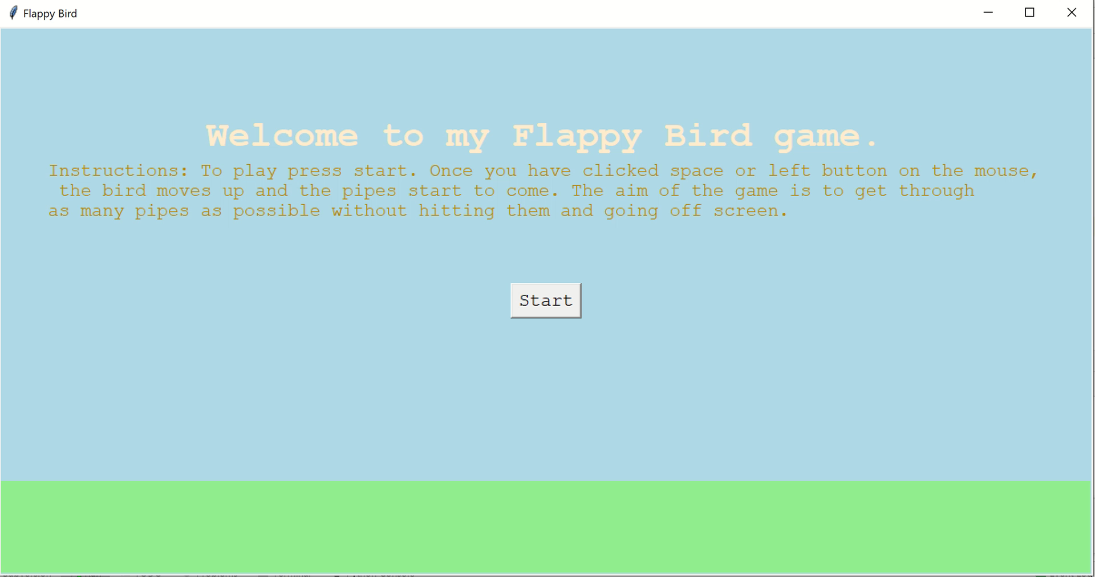
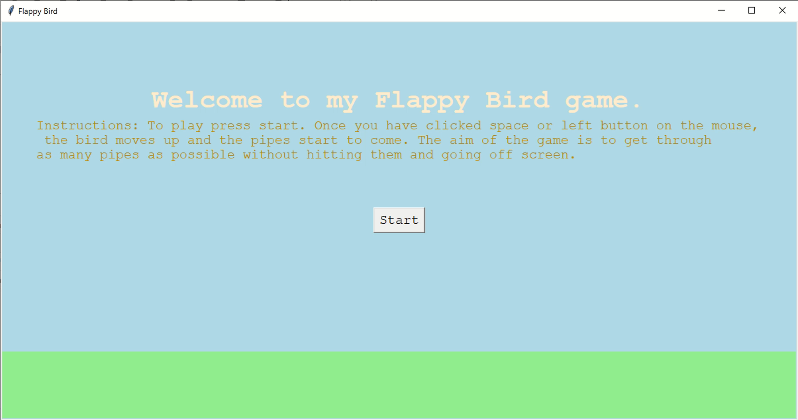
Testing moving_up (unexpected) random letters and numbers: Input: ‘ASDF1234’ Expected result: The bird should keep falling down faster and faster.
As you can see above as I’m pressing the keys ASDF12345 the bird keeps falling down at a constant rate
Fail
As you can see above as I’m pressing the keys ASDF12345 the bird keeps falling down faster and faster
Pass
*I forgot to add the + in front of the = sign (= instead of +=)

Slide 4
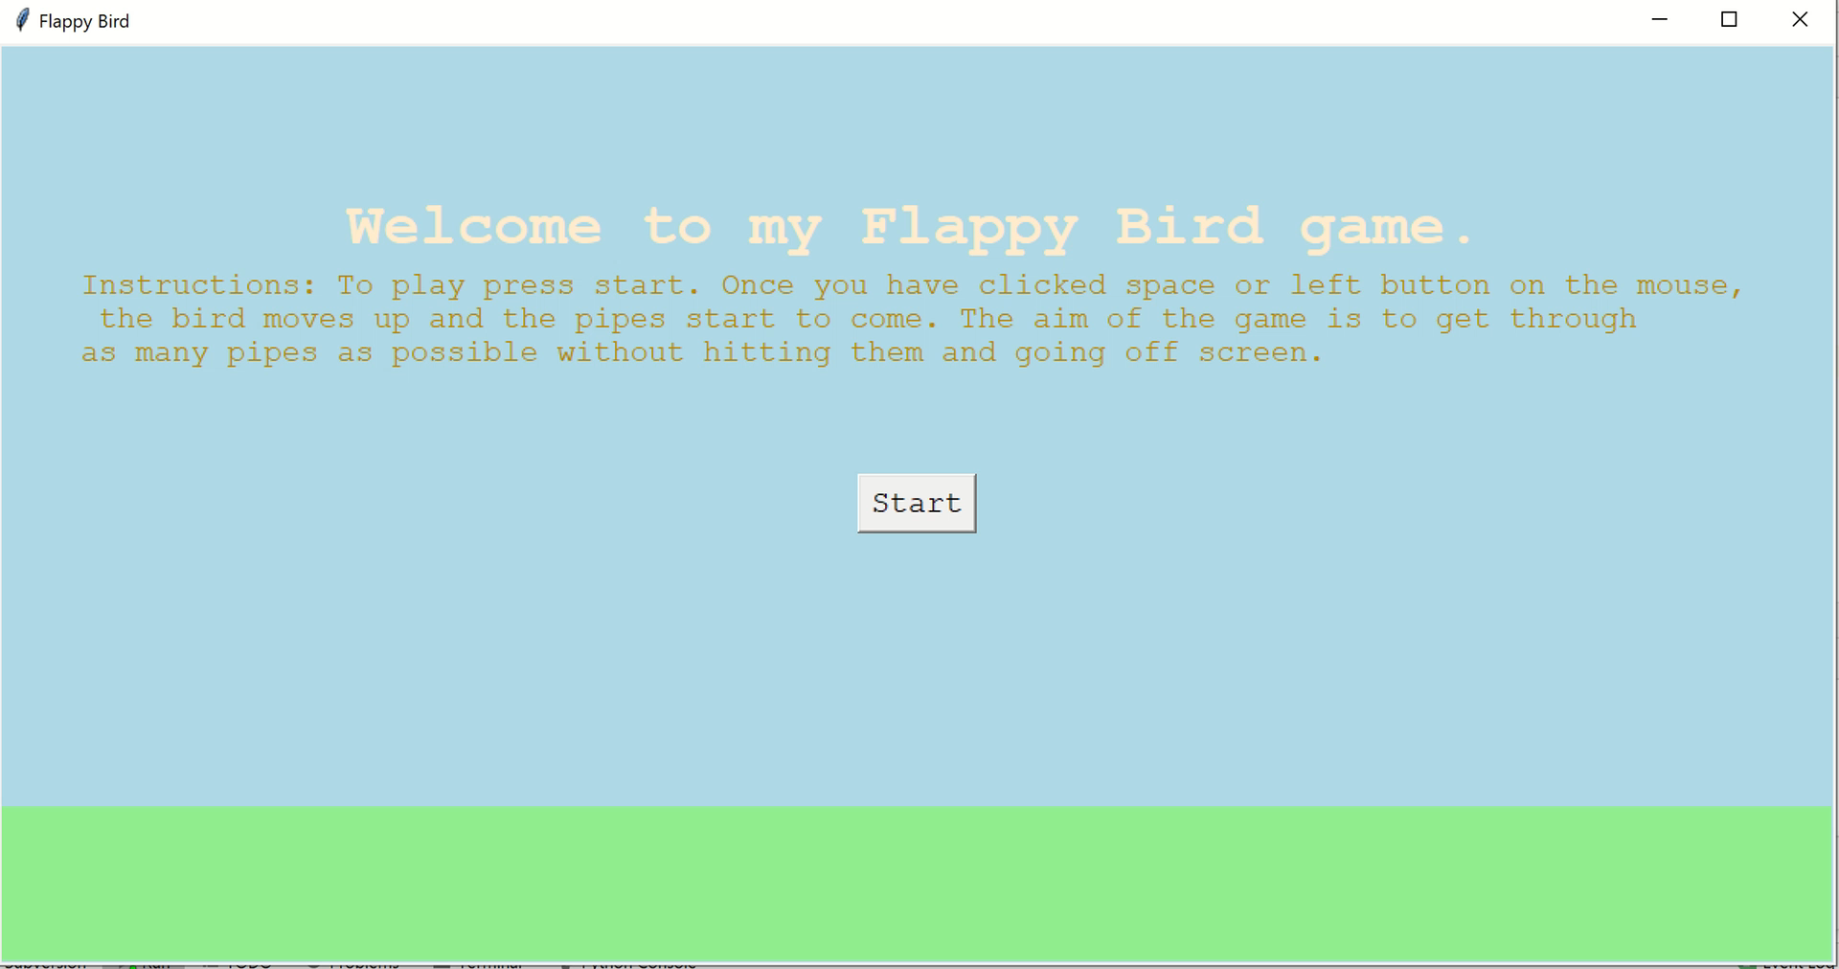
Testing moving_up (boundary): right mouse click Input: repeatedly clicking the right mouse button Expected result: The bird should keep falling down faster and faster.
As you can see above as I keep pressing the right mouse button, the bird keeps falling down faster and faster.
Pass

Slide 5
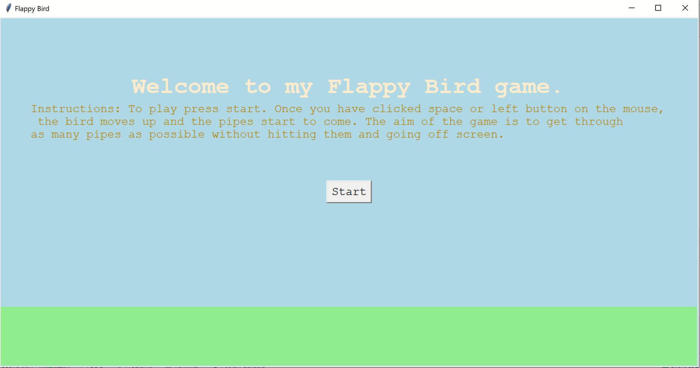
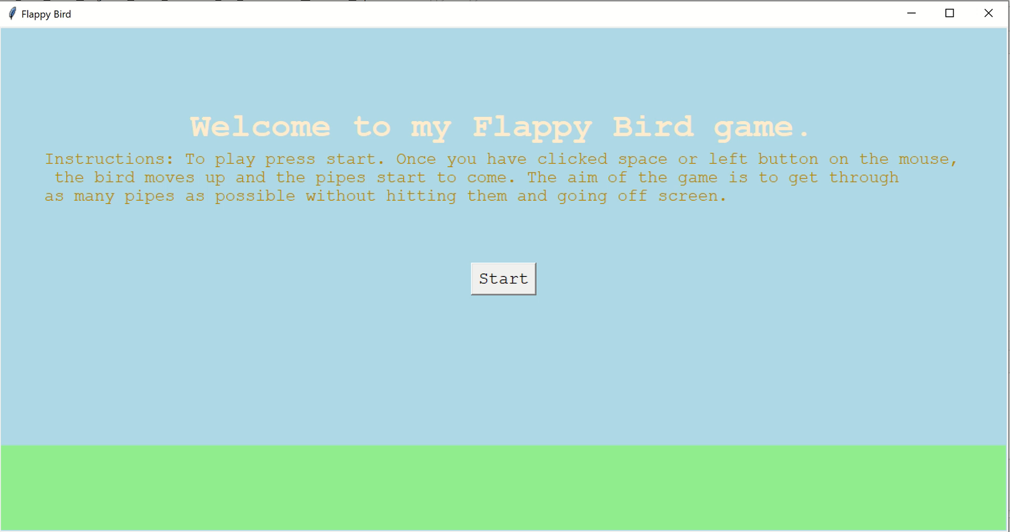
Testing moving_up (expected) space and left mouse button: Expected result: The bird should move up and then fall down faster and faster.
Input: Double Left Mouse Click
Input: Single space clicks
As you can see above when I click the left mouse button twice, the bird goes up and then falls down faster and faster.
Pass
As you can see above when I click space the bird goes up and then falls down faster and faster.
Pass

Slide 6
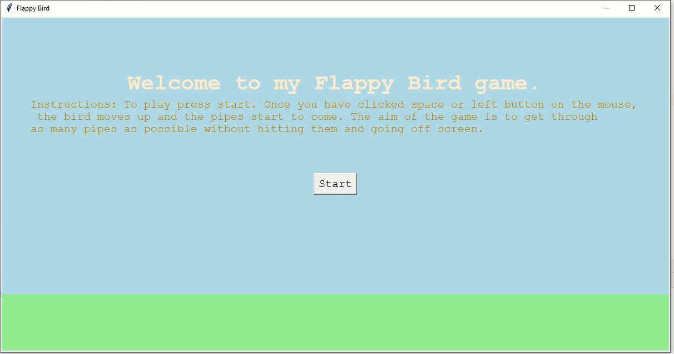
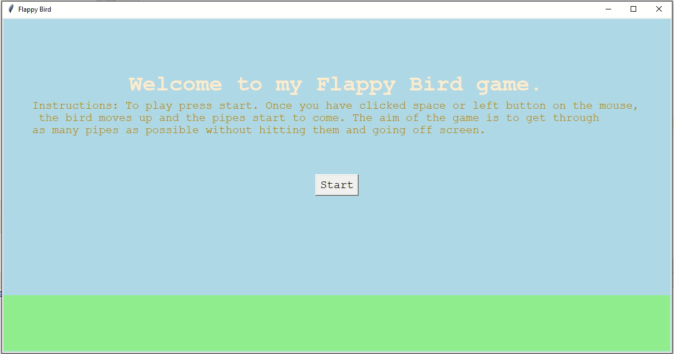
Testing score: Score should only increase when the bird has completely passed the pipe Expected result: The score shouldn’t increase until after the bird has passed the pipe. – Input is not applicable Expected: score is added to after player has passed. Boundary: the bird is partially through the pipes. Unexpected: the bird is just flying through the canvas.
As you can see above as when the bird pass the left hand side of the pipe it scores. It should only score after it has passed through the pipes.
Fail
As you can see above now when the bird is completely through and not partially through the pipes, one is added to the score
Pass
*I had the wrong x coordinate of the pipe
NOTE: After the first 3 set of pipes, pipes are at random heights. Expected is first 3 pipes are all the same boundary is the next set of pipes are different heights and unexpected is all the pipes being the same height. All Pass

Slide 7
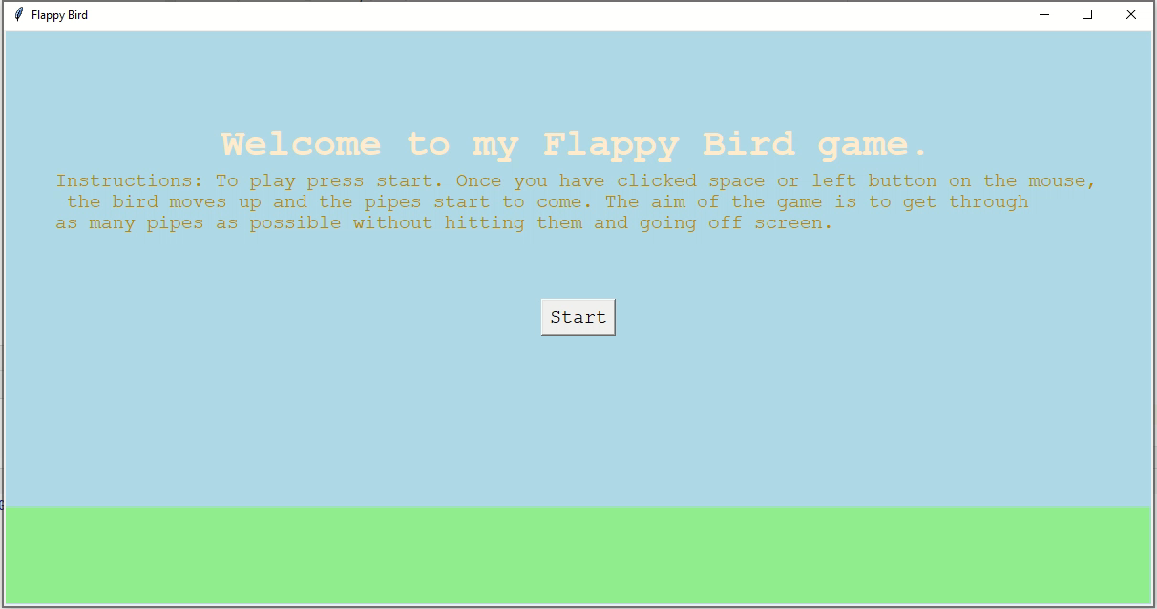
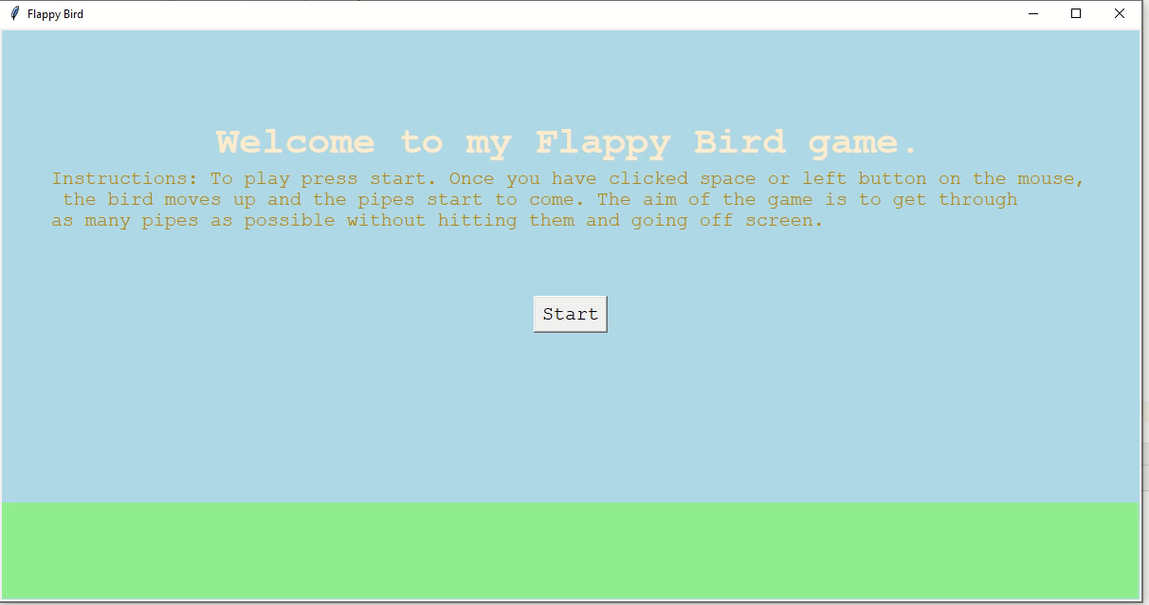
Testing game_over(boundary): partially going off screen: Expected result: It should keep going as it is only game over when the bird is completely off screen
Input: Let the bird go out through the top
Input: Let the bird out through the bottom
As you can see above when the bird is partially out it goes to the game over screen
Fail
Note: Bird stays in the centre of the screen that the game keeps going (unexpected case). Pass

Slide 8
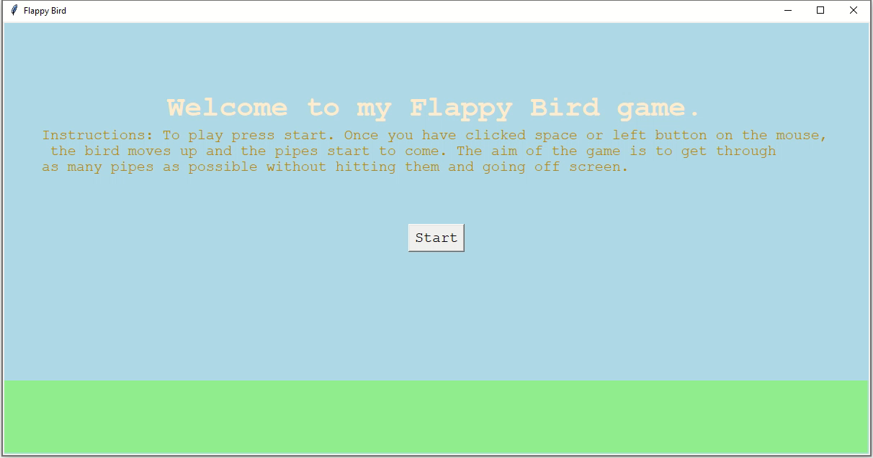
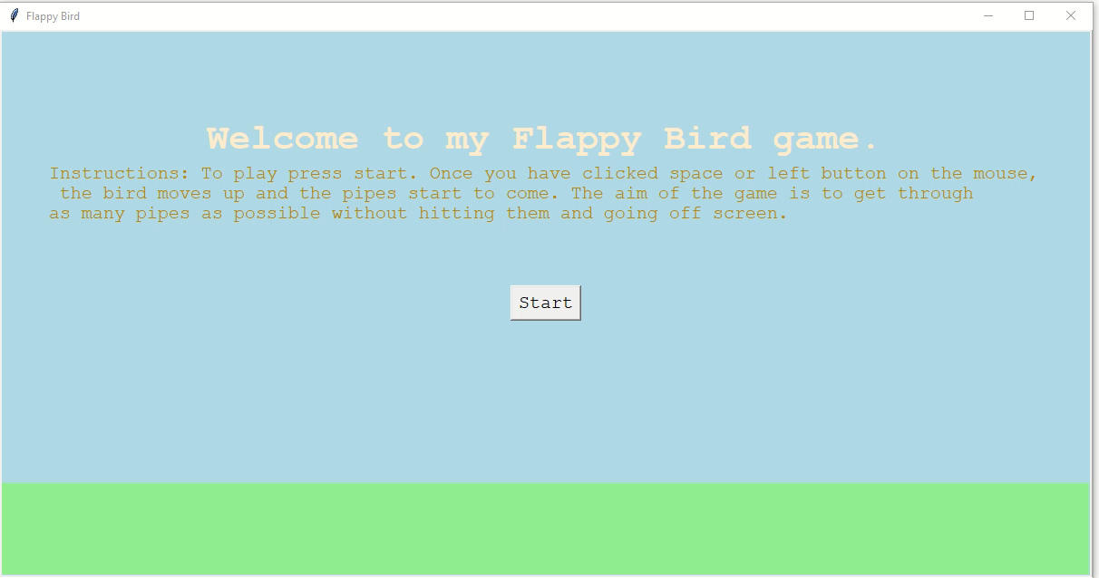
Testing game_over(boundary and expected): partially going off screen and going completely off: Expected result: When partially of the game should keep going and when the bird is completely off it should go to the game over screen
Input: Let the bird go out partially and completely through the top
Input: Let the bird go out partially and completely through the bottom
As you can see above when the bird is partially out it keeps going and when it’s completely out it goes to the game over screen. I had the wrong y coordinate of the bird.
Pass
Note: that after 3 seconds the screen gets destroyed in both cases(expected). Boundary is that it gets destroyed after anytime and unexpected is that it stays on until you close it. All Pass

Slide 9
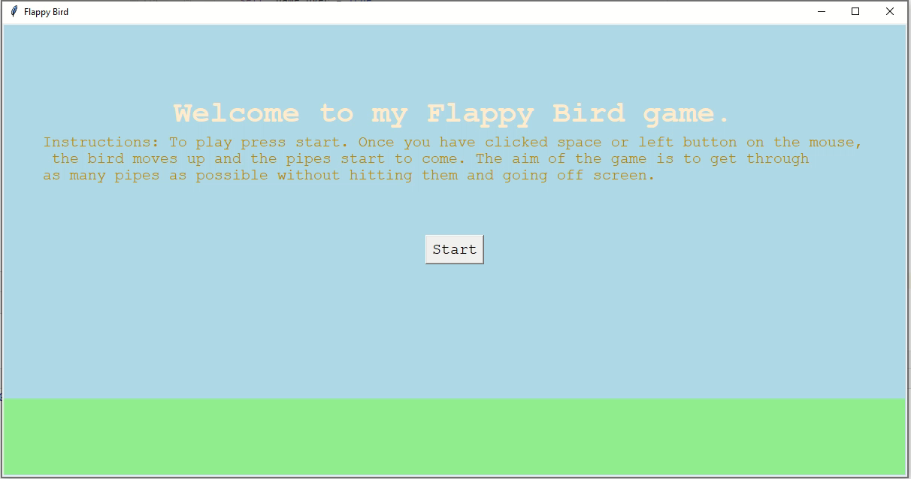

Testing game_over: touching the pipes: Expected result: When partially of the game should keep going and when the bird is completely off it should go to the game over screen
Input: Hit the top pipe
Input: Hit the bottom pipe
As you can see above when the bird hits the pipes it dies and it goes to the game_over screen.
Pass
Note: that has it passes through the pipes and flying through the canvas the game keeps (boundary and unexpected case respectively). Pass
Note: that the final score displayed in the top right hand corner is equal to the score displayed on the game over screen (functionality).

Slide 10
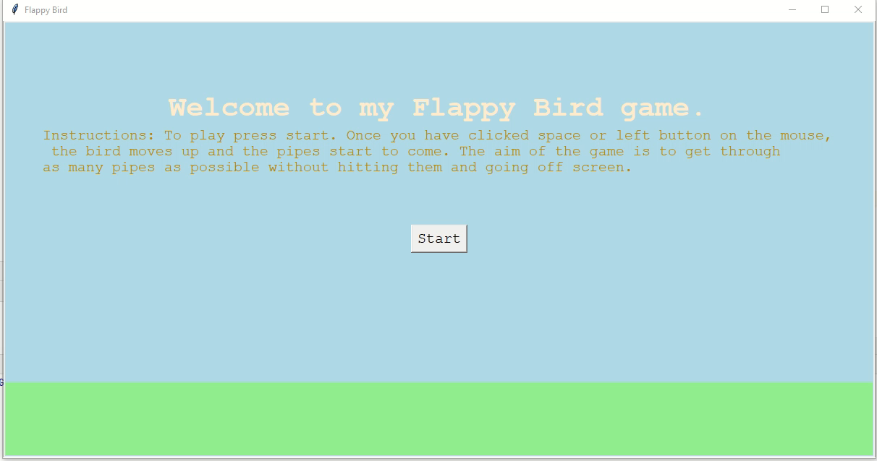
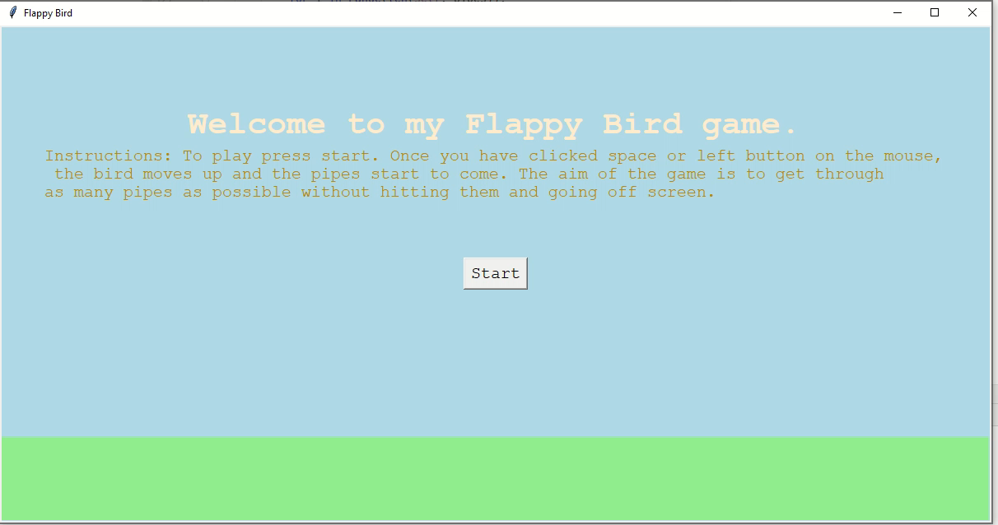
Testing start (unexpected) random letters and numbers: Input: ‘ASDF1234’ Expected result: Nothing should move at all.
As you can see above as I’m pressing the keys ASDF12345 the pipes are moving, the player doesn’t die or score
Fail
As you can see above as I’m pressing the keys ASDF12345 nothing happens.
Pass
*I forgot to add the + in front of the = sign (= instead of +=)
Note that the bird is created at a quarter way through as expected (boundary is anywhere else and unexpected is nowhere visible). Pass

Slide 11
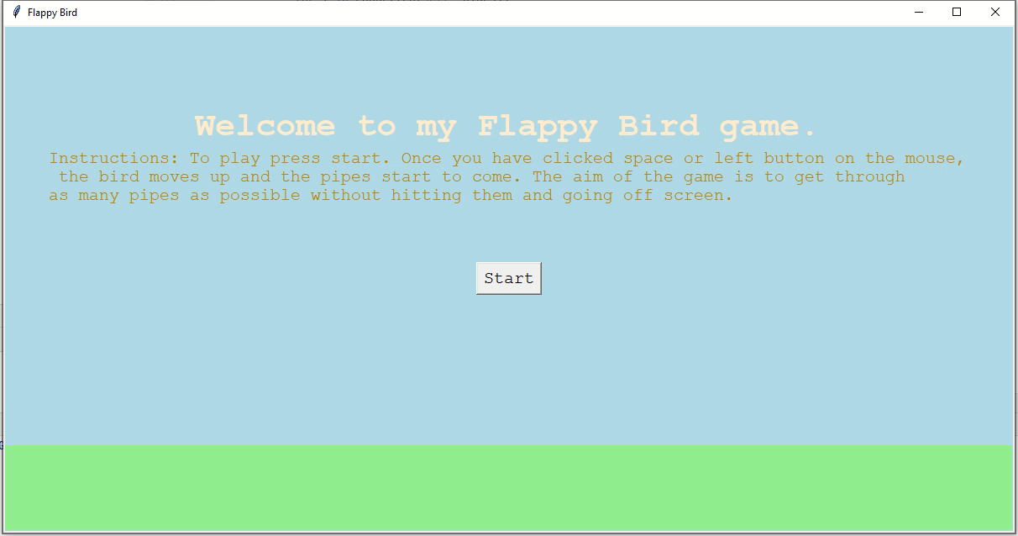
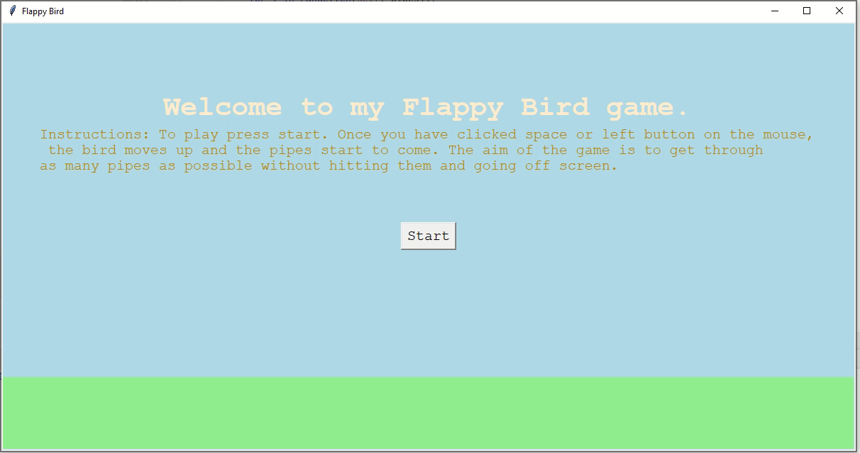
Testing start: space and left and right mouse button: Expected result: Once start has been pressed nothing should move (bird and pipes) until space or left mouse button is clicked. Boundary case is right mouse click, and space and left mouse button click are expected cases.
Input: Right mouse than Left Mouse Click
Input: Pressing space clicks
Above, when I click the right mouse nothing happens but when I click the left mouse button, the bird and the pipes start moving.
Pass
As you can see above when I click space the bird and the pipes start moving.
Pass

Slide 12
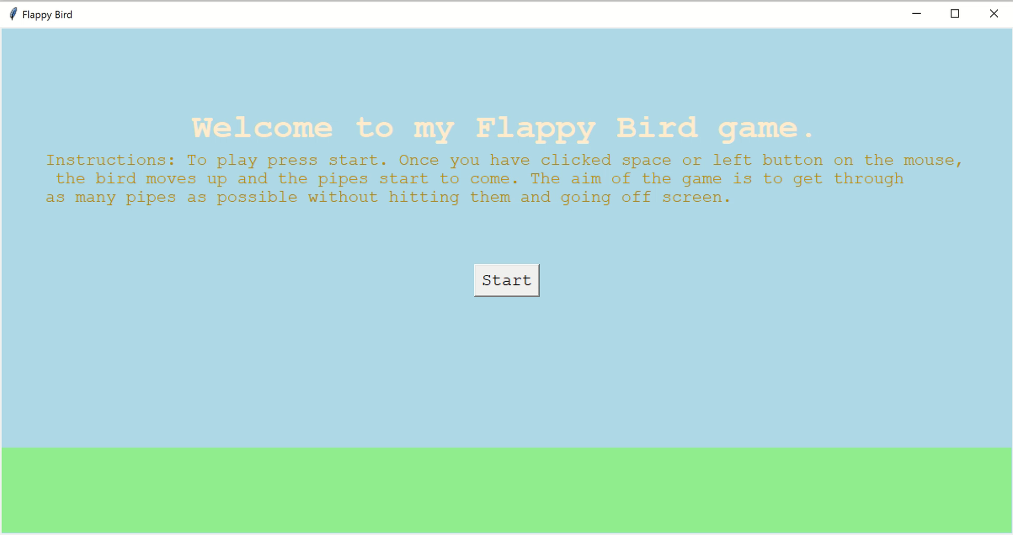
Testing widgets label + button: UNEXPECTED - is if the label shows up in the intro screen and button showing up in game_over. BOUNDARY: Label doesn’t get destroyed in the game over screen and the button shows up in the playing screen. EXPECTED: Label shows while playing in the top right hand corner and the button shown in the intro screen Expected result: Label is shown only in the playing screen.
As you can see above the score label is only shown in the playing screen and is destroyed in the game over screen. The button is only shown in the intro screen and destroyed once it goes to the playing screen.
Pass
Note: that the green rectangle is present in every screen like expected. Unexpected would be to show up nowhere and boundary to only be shown in the intro but not playing or game over screen. All Pass

